Slide 1


Power Distribution System
8102-8102
4th Year’s Lectures
Lecturer : Raghad Ali Mejeed Department of Power & Machines Engineering,
College of Engineering University of Diyala- Iraq
Dr.RaghadALjourni@engineening.uodiyala.edu.iq
dr.raghadaljourni@gmail.com

Slide 2
Syllabus
Distribution System Configuration
Various distribution system circuit components, representation and parameters, radial, ring, spike, spindle, and interconnected systems. Electrical Design of Distribution Systems.
Voltage level, selecting various system components, transformers, cables, overhead lines, switching and
protective gear, voltage drop & power loss calculations, economic considerations.
Distribution Inside Large Buildings
Single rising mains, individual floor supply, ring supply, double feed and grouped supply, vertical and
horizontal supply systems, main, sub-main, and final distribution boards.
Industrial Power Distribution
Special features, equipment layout, cable trenches, cable trays, earthing, emergency power supply.
Reactive Power Control in Distribution Systems
Individual, grouped, and centralized compensation, advantages, size and location of reactive power control
equipment.
Electrical Load Management
Objectives, devices controlled, various methods of load control, practical implementation problems.
Renewable Energy Plants
Types of renewable plants, selection the size and location of embedded renewable plants, applications.
Recommended Textbooks
1. Turan Gonen, Electric Power Distribution System Engineering, McGraw‐Hill 1986.
Gunter G. Seip, Electrical Installation Handbook, John Wiley, 3rd Ed, 2000.
Robert B. Hickey, P.E., Electrical Engineer’s Portable Handbook
McGraw‐Hill 2001.
T. L. Short, Electric Power Distribution Handbook, CRC Press, 2004.
William H. Kersting, Distribution System Modeling and Analysis.
CRC Press, 2002.

Slide 3
Introduction
*The electrical system of systems is highly complex and consists of three main parts.
1- Generation plant 2-Transmission lines 3-Distribution system
*The distribution system is divided into two parts: the primary distribution system and the secondary distribution system.
*The primary distribution system is the transfer of power from substations to distribution to distribution transformers The secondary distribution system transfers the power from the distribution transformers to the consumers.
*It is necessary to take care of the distribution system in terms of design, construction, operation and maintenance.
Distribution Systems
So the distribution system is the link between the generated power and consumers.
The electrical distribution system contains the following components 1-Subtransmission
2- Primary feeders
3-Distribution transformers 4-Primary feeders
5-Distribution transformers 6- Service drops

Slide 4
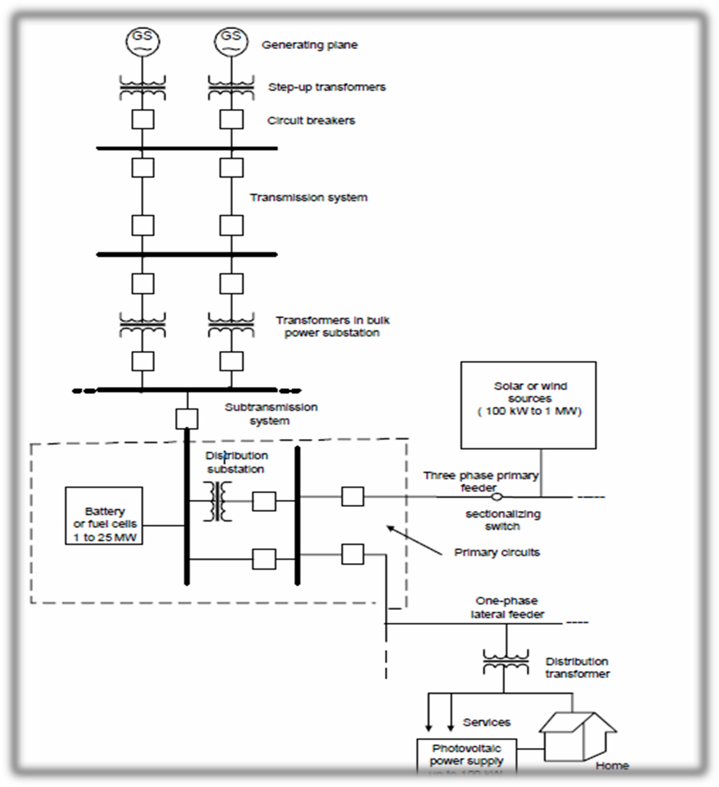
Figure (1) electric power system

Slide 5
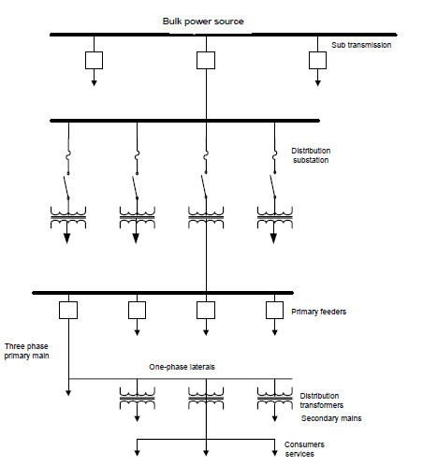
Figure (2) Distribution System

Slide 6
Distribution System Configuration
Distribution networks deliver electrical power from main substations sited within areas of load, to secondary substations within lower voltage level and then to individual consumers. These networks may have limited spread, but are characterized by their density and complexity. These factors distinguish them from HV and EHV networks which carry the power from generating centers, frequently over long distances to the areas of load.
•Within the concept “ Distribution Network” all systems up to 33KV are included. In densely loaded areas a network operating at voltage up to 132KV may be incorporated.
•In the design and development of distribution systems, the configurations schemes are selected and compared using the following principles:
The circuit should be reliable ( a fault in one part should not affect other healthy parts).
The circuit should be economical.
It should be simple in operation and maintenance.
It should be capable to meet future expansions without large financial costs.
It should have reasonable short circuit level.
Also consumer type and importance is considered.

Slide 7
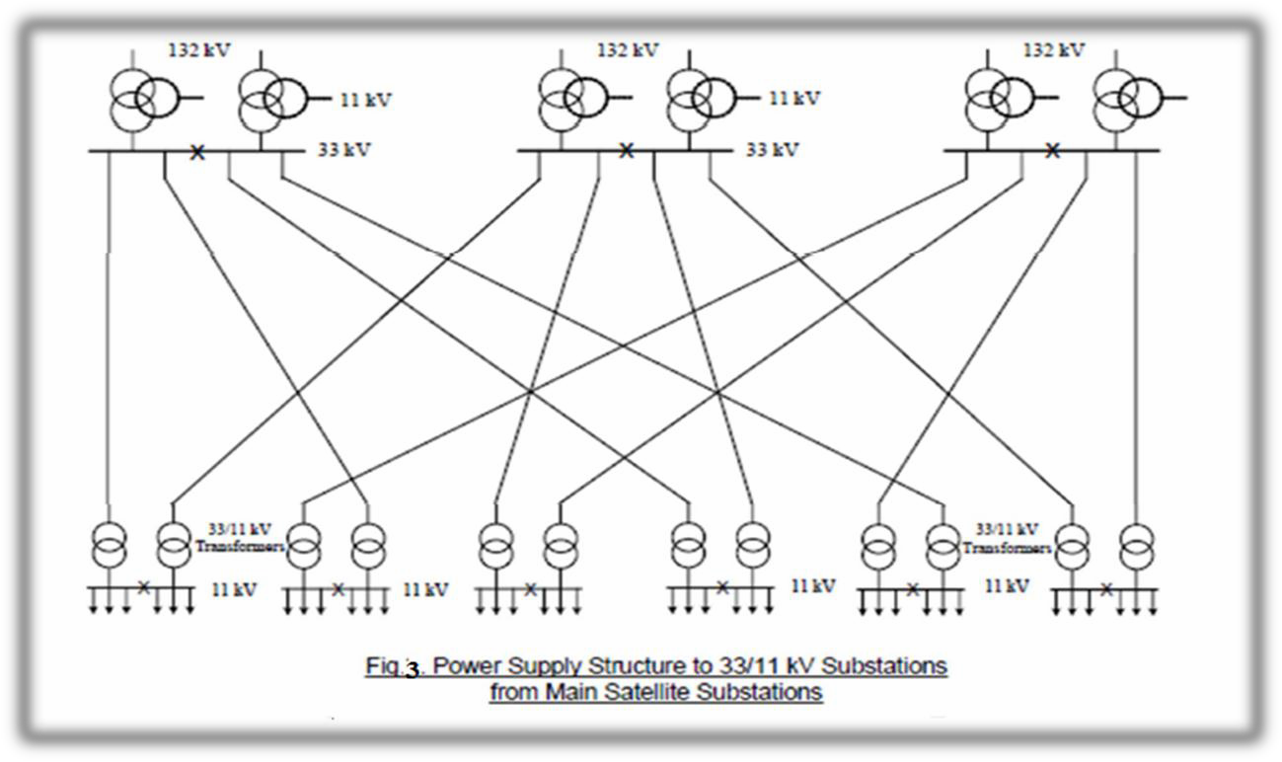
Consumer Types
0-First category: These consumers must be supplied from at least two independent sources,because any supply interruption might cause
losses in human lives, e.g. the operating theaters in hospitals, intensive care units,… etc.
8-Second category: These consumers must also be supplied from two independent sources, because the supply interruption event might cause high financial losses, e.g. the large industrial plants.
3-Third category: These consumers accept short time power interruption as it does not cause damages mentioned above.

Slide 8
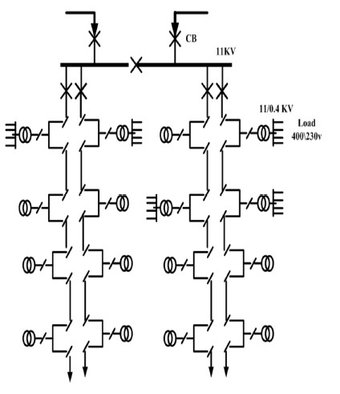
Distribution system Schemes
0- Radial System
In this system ,separate feeders are radiated from a single substation and feed distribution transformers from one end only.It is the simplest circuit and has the lowest initial cost but it the following drawbacks:
0-This circuit is not very reliable as in case of a fault in any feeder section, the supply to consumers who are in the side of fault a way
from the substation are interrupted.
8-Feeder end nearest to the substation will be heavily loaded.
3-The consumers at the distant end of the feeder would be subjected to voltage fluctuations when the load on the feeder is changed.

Slide 9
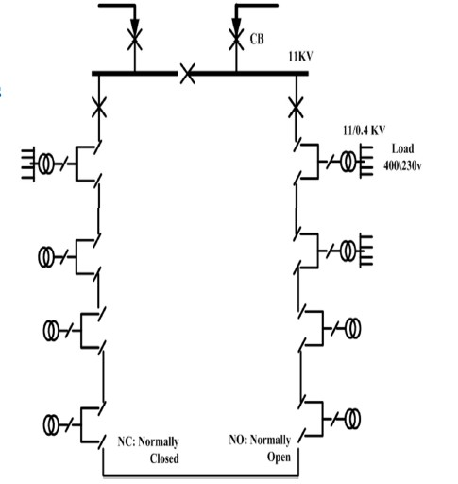
8- Ring System
In this system the primaries of distribution transformers forms
a loop . The loop circuit start from the substation bus-bar,makes a loop through areas to be served and returns to the substation as in figure.This circuit is very reliable but has a larger cost. Also each
side of the ring should not be loaded more than 50% of its rating to be able to accept the load of the other side in the case of fault.
Ring System
•Used where higher service reliability is required
•Generally more expensive than radial systems

Slide 10
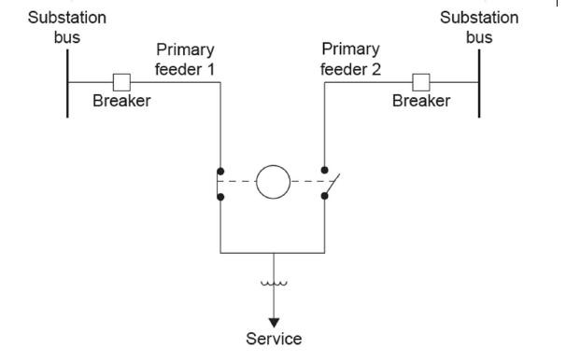
•Feeder conductors are sized to feed entire loop
•Loop systems can be used in underground residential distribution (URD), where faults are infrequent but are usually permanent.
Primary selective systems can be used as backup for critical loads such as hospitals.
3- Spike System
In this system, all secondary substation are supplied by using radial feeders. In addition a separate feeder is provided for emergency ( to provide power supply in the case of fault in the main feeder) . This system type is reliable and widely used.

Slide 11
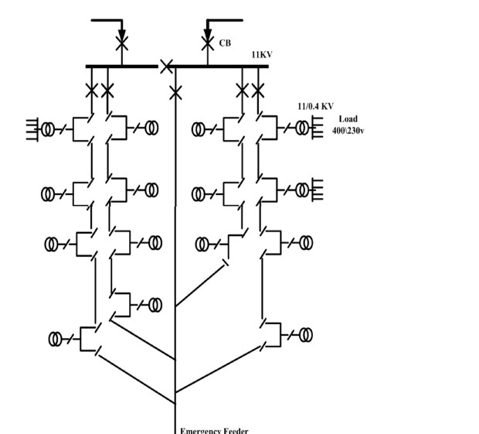
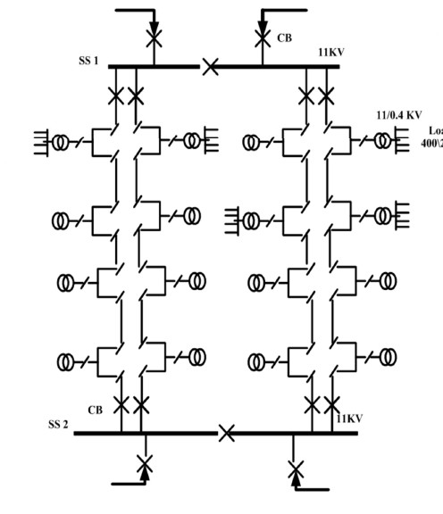
4- Spindle System
In this system, all secondary substations (distribution transformers) are supplied by using radial feeders. In addition a switching station is provided to connect the supply to the feeder with faulty section . This circuit is more expensive but reliable.

Slide 12
5-Grid system
This type is applicable in large distribution areas with large loads and where the system has to made more reliable for continuity of supply.
This is true for primary distribution systems as well as on some applications to secondary distribution systems . the primary network is a system of interconnected primary feeders supplied by two or more main substations through several secondary distribution substation located at intersection points of the interconnected feeders . This type is specified as
in following points
It is used where loads are heavy as in small crowded commercial areas .
It gives the maximum possible flexibility.
High reliability in continuity of service.
The best use of the advantage of diversity between loads.
It gives better voltage regulation.
The size of substation required is smaller to that required in redial system.
It use smaller length of feeders.
It accept any growth its circuit compared with other types .

Slide 13
